Slide 1
Building an Unbreakable Delivery Pipeline Shift-Left, Shift-Right, Self-Healing / Auto-Remediation Based on: https://github.com/Dynatrace/AWSDevOpsTutorial, ported to Concourse at https://github.com/akirasoft/PivotalDevOpsTutorial
Michael Villiger, Dynatrace @mikevilliger

Slide 2
PRE-REQUISITES Dynatrace SaaS git repo fly cli BOSH add-on

Slide 3
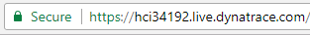
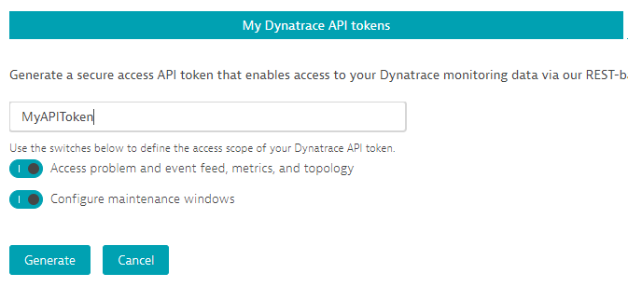
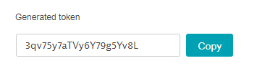
#1 - Prerequisites Sanity Check: Dynatrace
Login to your Dynatrace SaaS Trial we just gave you: http://signin.dynatrace.com
Make note of your Dynatrace Tenant URL
Create an API Token. Make note of that Token
Provide Tenant URL and apitoken to Mike so that he can rollout BOSH add-on to CloudFoundry isolation segments configured to point to your tenant!

Slide 4
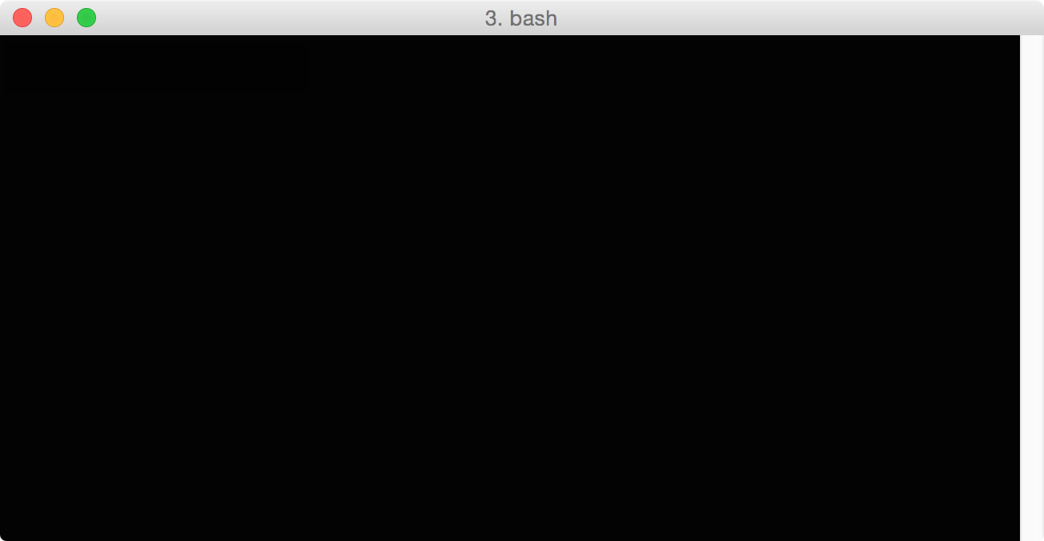
#2 - Prerequisites Sanity Check: clone git repo
Clone PivotalDevOpsTutorial workshop
$ git clone https://github.com/akirasoft/PivotalDevOpsTutorial.git
Cloning into 'PivotalDevOpsTutorial'...
remote: Counting objects: 837, done.
remote: Compressing objects: 100% (130/130), done.
remote: Total 837 (delta 130), reused 123 (delta 60), pack-reused 643
Receiving objects: 100% (837/837), 94.34 KiB | 0 bytes/s, done.
Resolving deltas: 100% (581/581), done.
Checking connectivity... done.
Checking out files: 100% (36/36), done.

Slide 5
#3 - Prerequisites Sanity Check: fly cli
Utilize fly cli to login to workshop Concourse instance
$ fly --target aws login --concourse-url https://bbl-env-ba-66f9ba8-concourse-lb-07041d6baa0ed7d4.elb.us-west-2.amazonaws.com --insecure --username admin --password C0nc0ur3L4b!
logging in to team 'main'
target saved

Slide 6
THE BIG PICTURE What we are going to do today!

Slide 7












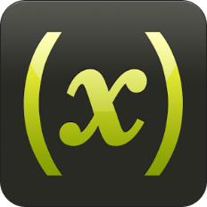




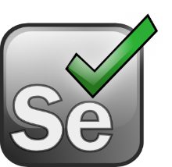










Shift-Left: Break Pipeline Earlier
Shift-Right: Tags, Deploys, Events
Dev
Perf/Test
Ops
Biz
Actionable Feedback Loops
Path to NoOps: Self-Healing, …
Notes:
But there is more than production! There is more we can do throughout the whole DevOps Toolchain

Slide 8


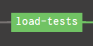
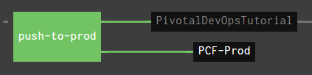
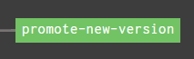


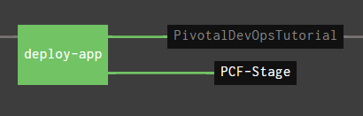

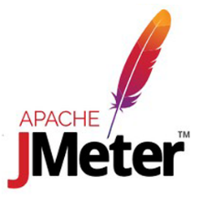


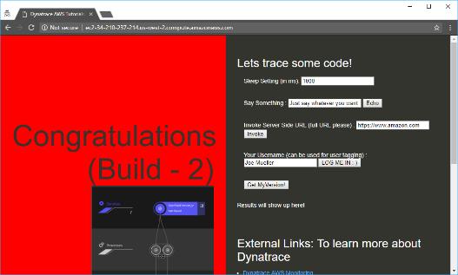
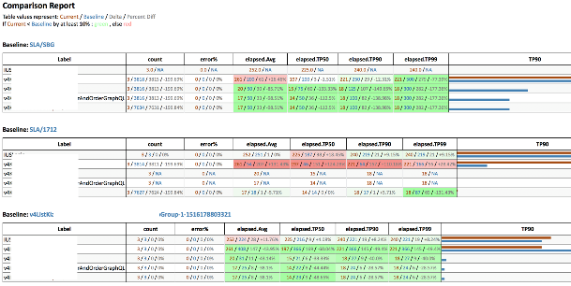
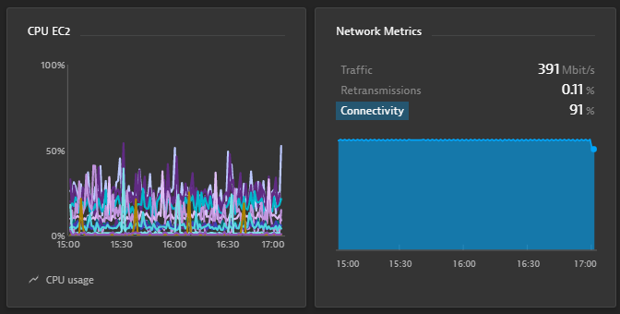
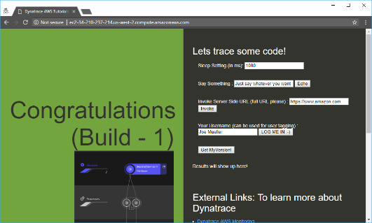
https://github.com/akirasoft/PivotalDevOpsTutorial
AppTeam
Users
Concourse
Concourse
Manual Approval
Manual Approval
Manual Rollback
CloudFoundry(Tag=Staging)
CloudFoundry (Tag=Production)

Slide 9
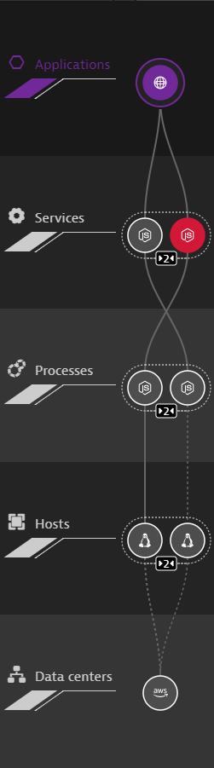
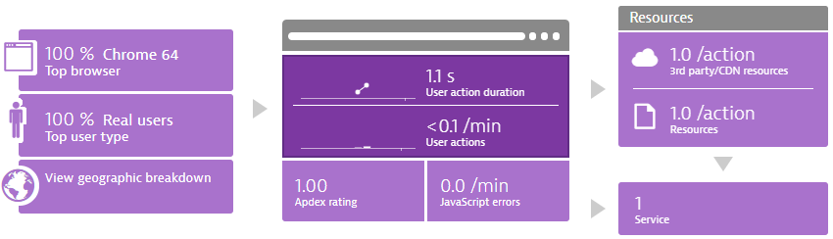
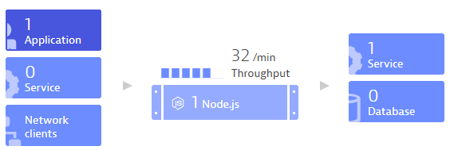
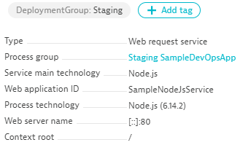


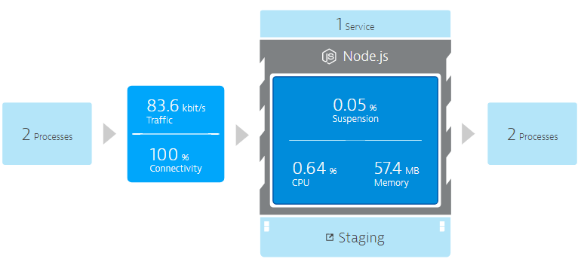
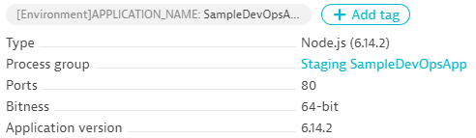
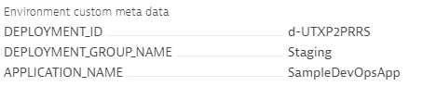

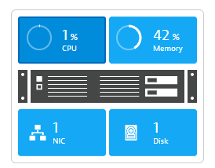
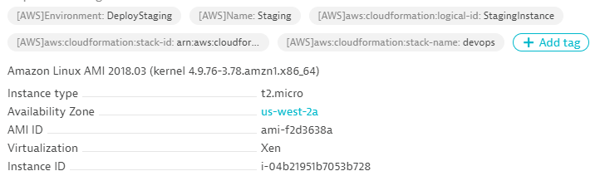


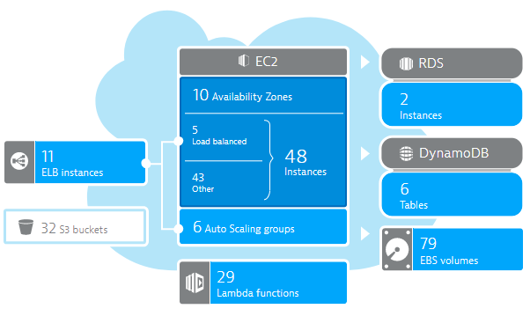
DT_CUSTOM_PROPS=Staging
cf push app
BOSH add-on
bosh deploy
AWS EC2 (Tag=Staging)
CloudWatch

Slide 10
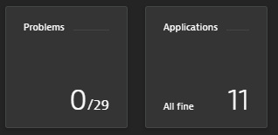

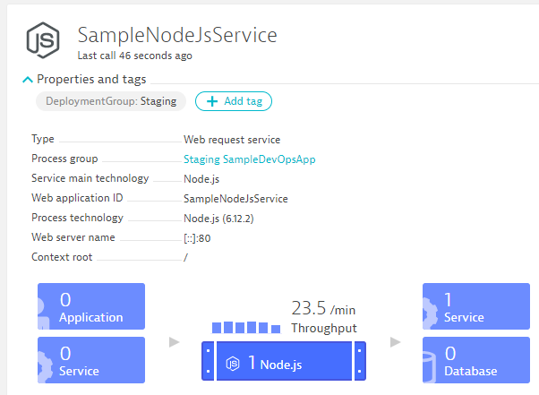
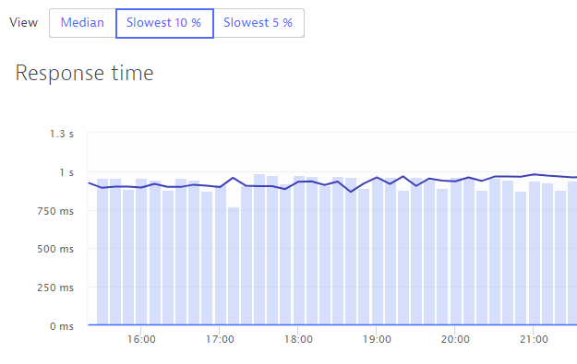
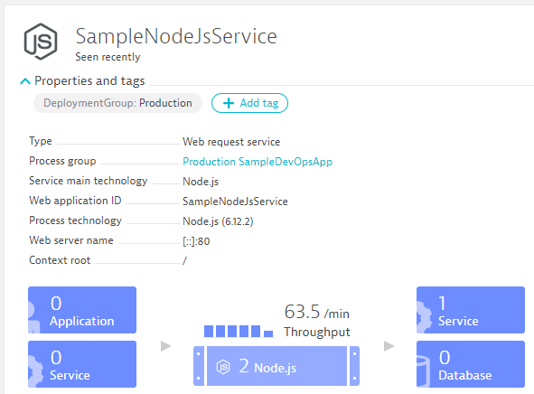
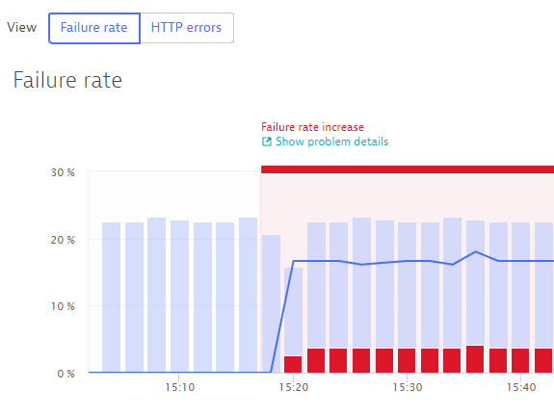
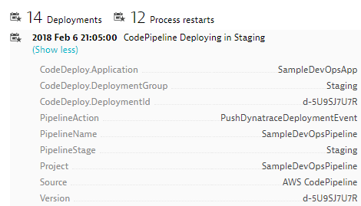
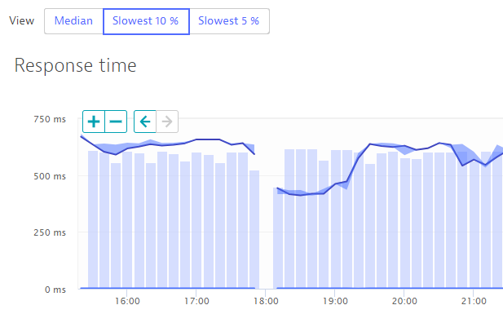
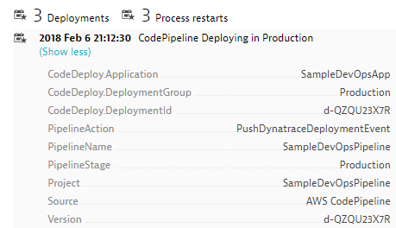
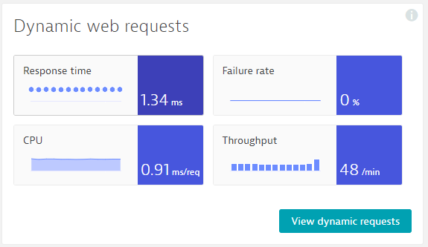
https://github.com/akirasoft/PivotalDevOpsTutorial
Auto-Approve!
Auto-Approve!
Auto-Reject!
Auto-Reject!
Dynatrace Concourse resource
Pushes Deployment Info to Dynatrace Entities
Validate-via-monspec task
Compares Builds and Approves/Rejects Pipeline
Dynatrace Concourse resource
Pushes Deployment Info to Dynatrace Entities
Validate-via-monspec task
Validates Production and Approves/Rejects Pipeline
Build 6
Production
Build 7
Production

Slide 11

A bit about Concourse

Slide 12
Concourse concepts
Pipelines represented as YAML, checked in as part of codebase
Highly abstracted, everything runs in a container
Resources
External locations to look for changes, get files, push changes
i.e. Github, S3, PCF, Dynatrace
Jobs
Steps of your pipeline, made up of Resources and Tasks
Tasks
Arbitrary steps of your pipeline, things like bash scripts and so on

Slide 13
Push out our first pipeline!
$ fly -t aws set-pipeline -c ci/01-pipeline.yml -p PivotalDevOpsTutorial -l ci/credentials.yml
groups:
group main has been added:
+ name: main
+ jobs:
+ - deploy-app
+ - load-tests
+ - push-to-prod
+ - promote-new-version
<snip>…
apply configuration? [yN]: y
pipeline created!
you can view your pipeline here: https://bbl-env-ba-66f9ba8-concourse-lb-07041d6baa0ed7d4.elb.us-west-2.amazonaws.com/teams/main/pipelines/PivotalDevOpsTutorial
the pipeline is currently paused. to unpause, either:
- run the unpause-pipeline command
- click play next to the pipeline in the web ui

Slide 14
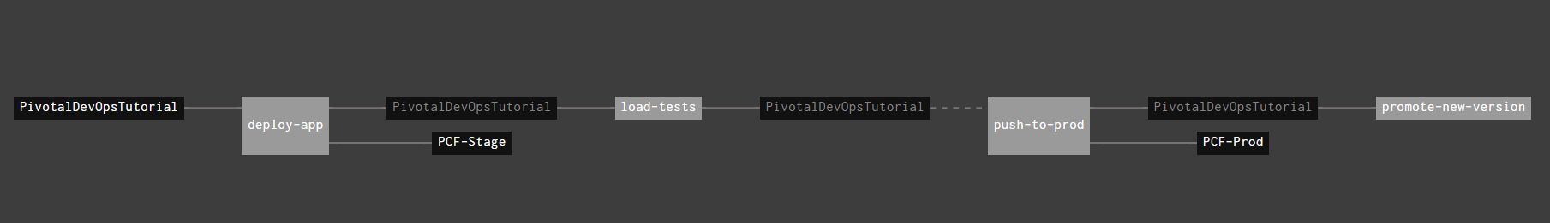
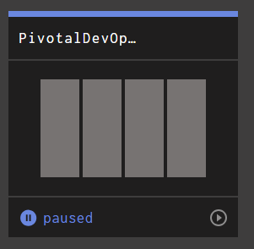
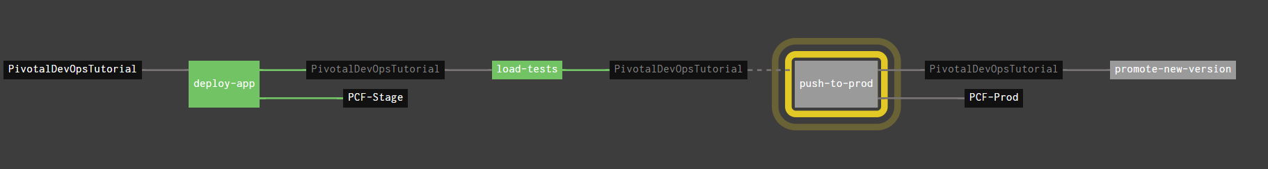
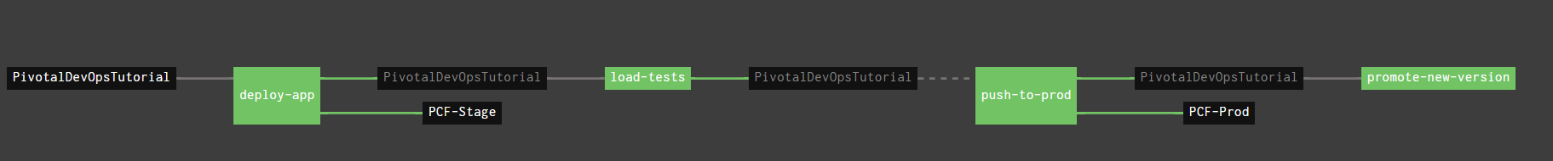
Unpause the pipeline!
Transitions to this!
Transitions to this!
Transitions to this!

Slide 15
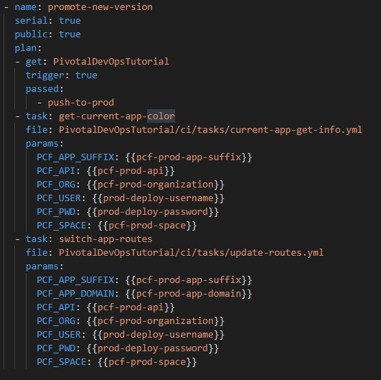
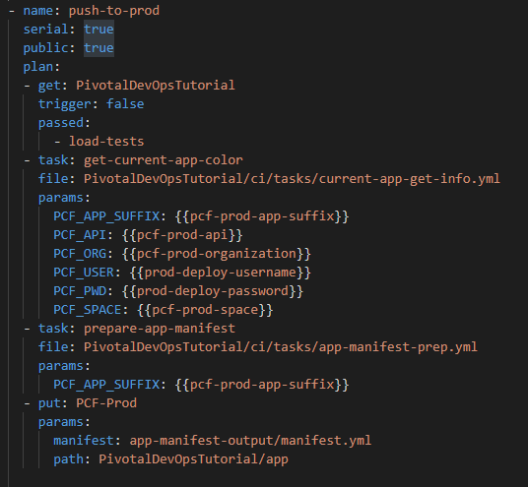
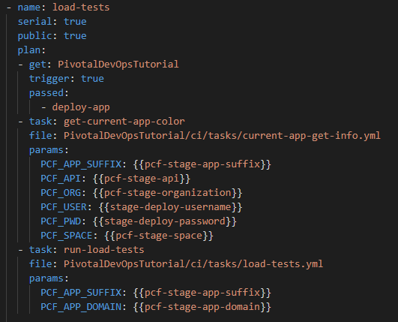
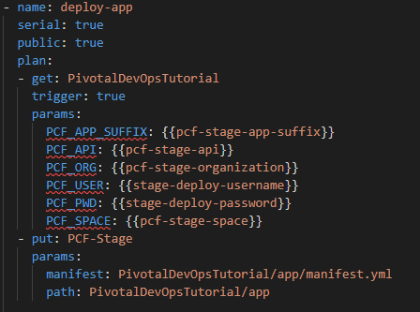
So what just happened?
Pipeline pushes our app out to Pivotal Cloud Foundry
Runs some load against staging
We manually approve the release by pushing to prod
Pipeline automatically does a blue/green deployment, switching routes as necessary!

Slide 16
Explore our environment The BOSH add-on did most of the work already

Slide 17


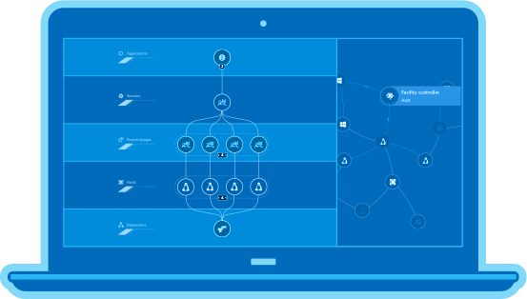


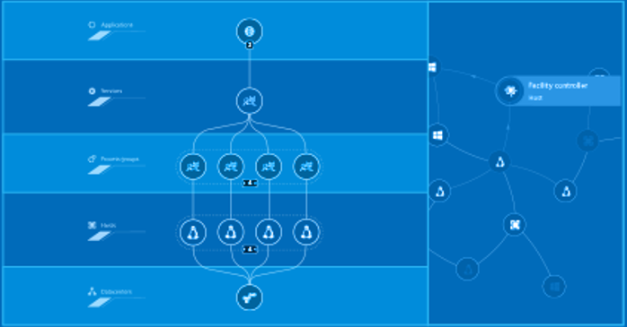










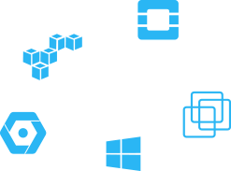


Dynatrace for Cloud Foundry
$ bosh runtime-config
releases:
- {name: dynatrace-oneagent, version: 0.3.3}
addons:
- name: dynatrace-oneagent-addon
jobs:
- name: dynatrace-oneagent
release: dynatrace-oneagent
$ bosh update runtime-config dynatrace-config.yml
$ bosh deploy
User
MySQL
Diego Cell
Garden
Garden
App
MongoDB
IaaS
Fully Automated
Full Stack
Powered by Artificial Intelligence

Slide 18
Our BOSH add-on lit up the following
Isolation segments for each workshop attendee
Essentially a segregated slice of what is shown in the previous slide’s animation:
1 isolated router
1 isolated diego cell
gorouter
Diego Cell
Garden

Slide 19
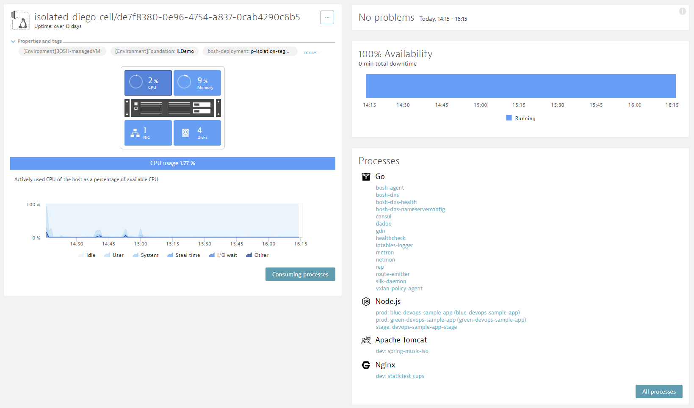
In Dynatrace Web UI: View Hosts and Validate monitored EC2 Instances
#2 Click on a Host! FullStack Monitoring Details of each PCF host

Slide 20
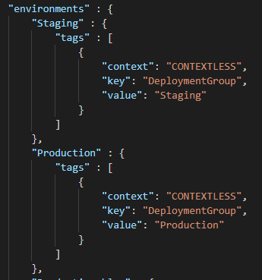
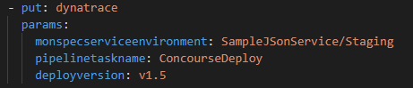

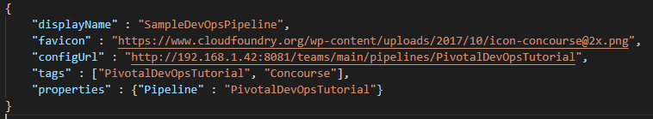
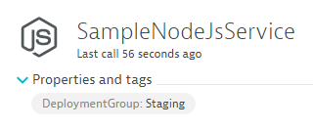
What does the Dynatrace Concourse Resource do? And WHY can it FAIL?
Dynatrace Concourse Resource
Pulls Information from Monspec
Issues REST API request to Dynatrace
Dynatrace Events REST API
Pushes Event for Entities with Tag DeploymentGroup:Staging

Slide 21

Configure Service Tagging Rules to Automatically apply Staging vs Production Tags
#2 – Call the Tag “DeploymentGroup”
#3 – For Services
#4– Tag Value comes from our Process Environment Variable, already part of CloudFoundry app manifest!
#5 – Only apply rule if env variable exists
#1

Slide 22

Configure Service Tagging Rules to Automatically apply Blue vs Green Tags
#2 – Call the Tag “DeploymentColor”
#3 – For Services
#4– Tag Value comes from our Process Environment Variable, already part of CloudFoundry app manifest!
#5 – Only apply rule if env variable exists

Slide 23

Service Naming Rules: Distinguish services between Staging and Production
#2
#3
DEPLOYMENT_GROUP_NAME/Detected ServiceName
#1
Only when DEPLOYMENT_GROUP_NAME exists

Slide 24

Lets Explore our Application in Staging: Not a Web UI Masterpiece – but it works ☺
In your Browser: http://$pcfstage-app-suffix.apps.pcfeu.dev.dynatracelabs.com

Slide 25
Second Pipeline: Shift-Right: Version Information, Tags, Meta Data, …

Slide 26



We can use Concourse to prepare a Custom Device to store our monspec data!

Slide 27
Push out the second pipeline!
$ fly -t aws set-pipeline -c ci/02-pipeline.yml -p PivotalDevOpsTutorial -l ci/credentials.yml
groups:
group main has changed:
name: main
jobs:
- deploy-app
- load-tests
- push-to-prod
+ - load-tests-prod
- promote-new-version
group init has been added:
+ name: init
+ jobs:
+ - init-dynatrace
<snip>…
apply configuration? [yN]: y
configuration updated

Slide 28


Explore our Services in Dynatrace: Everything Monitored, Everything Tagged
#1: Service renamed based on rules
#2 Our DeploymentGroup tag
#3 Our Deployment Event
Created by Dynatrace Concourse Resource

Slide 29



CloudFoundry manifests used for Staging & Production: We can validate in Dynatrace!
Appname Dynamically configured
Appname Dynamically configured
Production and blue
Staging

Slide 30



Concourse also used to deploy a “Load Test” via artillery…

Slide 31
Behind the Scenes: Deployment Shift-Right: Version Information, Tags, Meta Data, …

Slide 32










Shift-Right: Tags, Deployments & Events
Release
Automation
Dynatrace Automation
API, CLI, Auto-Detection
Dynatrace Smartscape
docker run –e DT_TAGS=BLUE
dtcli tag srv CartServicev2 GREEN
dtcli evt push pg tomcat1 desc=JVMMemIncr hint=+100MB
dtcli evt push host .*demo version=123 source={code_deploy}

Slide 33



@ Deployment: Passing Meta Data to launched processes
CF Appname, transformed with naming rule
DT_CUSTOM_PROP

Slide 34



@ Deployment: Converting Process Meta Data to Tags on Services!
Via Tagging Rules

Slide 35


@Deployment: Pass Deployment Information to Deployed Entities
Dynatrace Events REST API
Dynatrace Concourse Resource
Pulls Information from Monspec
Issues REST API request to Dynatrace

Slide 36
Monitoring as Code (Monspec): Define Services and their Environments as Code
Dynatrace Concourse Resource
Pulls Information from Monspec
Issues REST API request to Dynatrace
Dynatrace Events REST API
Pushes Event for Entities with Tag DeploymentGroup:Staging

Slide 37
Third Pipeline Shift-Left: Automate Metric Comparison to Validate Build

Slide 38
Push out the third pipeline!
$ fly -t aws set-pipeline -c ci/03-pipeline.yml -p PivotalDevOpsTutorial -l ci/credentials.yml
groups:
group main has changed:
name: main
jobs:
- deploy-app
- load-tests
+ - validate-stage-load-test
- push-to-prod
- load-tests-prod
+ - validate-prod-load-test
- promote-new-version
<snip>…
apply configuration? [yN]: y
configuration updated

Slide 39



Validate Nonfunctional Requirements defined in Monspec!

Slide 40
Behind the Scenes: Approval Stage Shift-Left: Automate Metric Comparison to Validate Build

Slide 41


Inspired by Continuous Performance Teams @ Dynatrace, Intuit, REI, PayPal …
“Performance Signature” for Build Nov 16
“Performance Signature” for Build Nov 17
“Performance Signature” for every Build
“Multiple Metrics” compared to prev Timeframe
Simple Regression Detection
per Metric

Slide 42


Monitoring as Code: Compare Metrics of Services of Different Environments/Builds
Entity: SampleJSonService
Different Metrics
Environment: Staging
Tag: DeploymentGroup:Staging
Environment: Production
Tag: DeploymentGroup:Production
Metrics: ResponseTime (Avg)
Metrics: ResponseTime(Max) < 10s
Metrics: FailureRate(Avg)
Metrics: ResponseCount
Factor: 90% Less vs Production
Different Comparisons
Compare: StagingToProduction
Source: Staging; Compare: Prod
Factor: Staging = 10% Slower
Compare: StagingToProdYesterday
Source: Staging; Compare: Prod
Factor: 10%, Timeshift: 86400s
Compare: StagingToStagingLastHour
Source: Staging; Compare: Staging
Factor: 0; Timeshift: 3600s
Compare: StageToStageYesterday
Source: Staging; Compare: Staging
Factor: 0; Timeshift: 86400s
Pipeline Run: Validate Build with StagingToProduction
Source (Staging): 1.64ms
Environment: Staging
Environment: Production
Compare (Production): 1.41ms
Threshold (+10%): 1.56ms
Status: VIOLATION

Slide 43



Automate the Comparison: Trigger it for each Build and Automate Approval!
Comparisons
Entity
Comparisons
Metrics

Slide 44
Monitoring as Code: The Full Picture
monspec.json
{
"SampleJSonService" : {
"etype": "SERVICE", // "Options are SERVICE, APPLICATION, HOST, PROCESS_GROUP_INSTANCE"
"name": "SampleNodeJsService",
"environments" : {
"Staging" : {
"tags" : [
{
"context": "CONTEXTLESS",
"key": "DeploymentGroup",
"value": "Staging"
}
]
},
"Production" : {
"tags" : [
{
"context": "CONTEXTLESS",
"key": "DeploymentGroup",
"value": "Production"
}
]
}
},
Entity: What Entity do we want to validate?
Environments: Tell us how we can detect these entities in Dynatrace

Slide 45
Monitoring as Code: The Full Picture
Comparision: Which environments do we compare and how!
monspec.json
{
"SampleJSonService" : {
...
"comparisons" : [
{
"name" : "StagingToProduction",
"source" : "Staging",
"compare" : "Production",
"scalefactorperc" : {
"default": 10,
"com.dynatrace.builtin:service.requestspermin" : 90
},
"shiftcomparetimeframe" : 0,
"shiftsourcetimeframe" : 0,
},
{
"name" : "StagingToProductionYesterday",
"source" : "Staging",
"compare" : "Production",
"scalefactorperc" : {
"default": 10,
"com.dynatrace.builtin:service.requestspermin" : 90
},
"shiftsourcetimeframe" : 0,
"shiftcomparetimeframe" : 86400
}
monspec.json
{
"SampleJSonService" : {
...
"comparisons" : [
{
"name" : "StagingToStagingLastHour",
"source" : "Staging",
"compare" : "Staging",
"scalefactorperc" : { "default": 0},
"shiftsourcetimeframe" : 0,
"shiftcomparetimeframe" : 3600
},
{
"name" : "ProductionToProductionLastH",
"source" : "Production",
"compare" : "Production",
"scalefactorperc" : { "default": 0},
"shiftsourcetimeframe" : 0,
"shiftcomparetimeframe" : 3600
}
],

Slide 46
Monitoring as Code: The Full Picture
monspec.json
{
"SampleJSonService" : {
...
"perfsignature" : [
{
"timeseries" : "com.dynatrace.builtin:service.responsetime",
"aggregate" : "avg", // min, max, avg, sum, median, count, percentile
"validate" : "upper", // upper or lower
// "upperlimit" : 100, // Optional: Can be used to define a FIXED THRESHOLD
// "lowerlimit" : 50, // Optional: Can be used to define a FIXED THRESHOLD
},
{
"timeseries" : "com.dynatrace.builtin:service.responsetime",
"aggregate" : “p90"
},
{
"timeseries" : "com.dynatrace.builtin:service.failurerate",
"aggregate" : "avg"
},
{
"timeseries" : "com.dynatrace.builtin:service.requestspermin",
"aggregate" : "count",
“validate" : "lower"
}
],
Metrics: Which Metrics, Aggregation, Upper/Lower Boundaries

Slide 47
Behind the Scenes: Self-Healing Smart Remediation based on AI-Detected Problems

Slide 48











Path to NoOps: Better and Smarter Auto-Remediation, Self-Healing, …
?Escalate at 2AM?
…
Auto Mitigate!
…
?
1
CPU Exhausted? Add a new service instance!
2
High Garbage Collection? Adjust/Revert Memory Settings!
4
3
Issue with BLUE only? Switch back to GREEN!
4
Hung threads? Restart Service!
Update Dev Tickets
3
?
Impact Mitigated?
2
Mark Bad Commits
5
Still ongoing? Initiate Rollback!
1
Escalate
5
?
Still ongoing?

Slide 49
Simulating Different “Bad” Builds
Application looks for Env variable BUILD_NUMBER during startup. Allowed values, 1, 2, 3, 4
Build Number | Behavior
1 | No Problem
2 | 50% of requests return HTTP 500
3 | No Problem
4 | Staging OK. 10% Requests fail in Production
To Deploy a different build:
Simply change “BUILD_NUMBER” in manifest.yml + commit the change to github
Deployment happens automagically
REMEDIATION HAPPENS AUTOMATICALLY, IN THE PIPELINE!
Build 2 should fail Stage
Build 4 should fail prod promotion

Slide 50






How it works post deployment with AWS Lambda and AWS CodeDeploy
#1: Push Deployment Information, e.g: CodeDeploy DeploymentId
#3
Uses Dynatrace Events API
to pull CUSTOM_DEPLOYMENT events
#2: Calling Lambda via API Gateway
#4: Redeploy previous revision
handleDynatraceProblemNotification
#5: Push comment to Dynatrace

Slide 51

Still sorting out post-deploy with Concourse, here is a proposed solution:
#1: Push Deployment Information, e.g: Deployment color, version, etc
#3
Uses Dynatrace Events API
to pull CUSTOM_DEPLOYMENT events
Executing Concourse job via API request
#4: Redeploy previous color
Job: rollback-to-previous-app-color
#5: Push comment to Dynatrace

Slide 52
Additional Features to Explore IOT Information Radiators: Dynatrace UFO

Slide 53

Dynatrace UFO, easily visualize pipeline status

Slide 54


Dynatrace UFO, easily visualize pipeline status, in Pivotal’s Toronto office!

Slide 55
Dynatrace UFO, easily visualize pipeline status, in Pivotal’s Toronto office!

Slide 56



Easily set UFO status LEDs with Dynatrace UFO resource
IP defined once in resources block
Success or Failure automatically sets LEDs on UFO_ROW to UFO_COLOR

Slide 57
Example pipeline included in repo:
$ fly -t aws set-pipeline -c ci/04-pipeline.yml -p PivotalDevOpsTutorial -l ci/credentials.yml
resources:
resource ufo has been added:
+ name: ufo
+ type: dynatrace-ufo-resource
+ source:
+ UFO_IP: 192.168.1.188
resource types:
resource type dynatrace-ufo-resource has been added:
+ name: dynatrace-ufo-resource
+ type: docker-image
+ source:
+ repository: mvilliger/dynatrace-ufo-resource
<snip>…
apply configuration? [yN]: y
configuration updated

Slide 58
Additional Resources & Reminders
Get your Dynatrace SaaS or Managed Trial: https://dynatrace.com/pcftrial
Dynatrace Concourse resources:
Dynatrace Resource: https://github.com/akirasoft/dynatrace-resource
Dynatrace UFO Resource: https://github.com/akirasoft/dynatrace-ufo-resource
Online Training Material
Dynatrace University: http://university.dynatrace.com
Dynatrace FullStack YouTube Playlist: http://bit.ly/oneagenttutorials
Dynatrace Coffee Breaks: http://dynatrace.ai/coffeebreak
Dynatrace Power Demos: https://www.dynatrace.com/demos/
Sample Applications, Tutorials & more
easyTravel: http://bit.ly/dteasytravel
AWS Tutorial w Sample Apps: https://github.com/Dynatrace/AWSMonitoringTutorials
Dynatrace CLI: https://github.com/Dynatrace/dynatrace-cli
PurePerformance Podcast: http://bit.ly/pureperf

